Slide 1


iMentor Project
December 15, 2016
Team Awesome

Slide 2
iMentor Background
Where?
Serves more than 6,000 students through its direct-service programs in New York City, Chicago, and the Bay Area
Who?
iMentor is a non-profit organization that facilitates mentoring relationships to ensure more students from low-income communities enroll and graduate from college.
How?
By partnering with public high schools, the program matches students with mentors for the majority of their high school career.
Weekly messages and chat conversation
Monthly in-school meetings and many more!

Slide 3

Problem Statement:
Mentor persistence
With the ultimate goal of college completion, one of the iMentor’s Core Metrics of quality is Mentors under the program execution rubric. A mentor dropping out of the program before its full length could impact the mentee’s success in the program.

Slide 4
Understanding the problem
High dropout in year 2-3
2 Program Types
Any indicators?
iMentor’s own analysis revealed that a significant percentage of mentors do not complete the 3- or 4-year mentoring commitment, with most dropping out over the second and third year.
College Ready (4-year program)
College Transition (3-year program)
Mentors demographic attributes
Mentors behavior: message frequencies, responsiveness and length

Slide 5

Project objective:
Establish a successful framework for repeatable and continued analysis of possible indicators of mentors dropout

Slide 6

In scope
The analysis will cover:
Mentors demographic information
Message log data for one school year 15-16 i.e. excludes the content of messages
Mentors participating in iMentor NYC only
Note 1: Additional datasets are still processed in our ETL since will be used in the future analysis.
Note 2: Further data is recommended to be included as a next step of this project.

Slide 7
Analysis Framework

Slide 8






Framework Chart
Data sources
Data files
Data ingestion and transformation
Data extraction and merge
Additional transformation and analysis
Report and Visualization
iMentor Online Platform
Dept of Education
Match history
Mentor demographic
Message logs
iMentor master file
Postgres SQL database
Match + Demographic
Message logs mentor + mentee
Graphs and Maps
Predictive Analysis
Time Series Analysis
Report

Slide 9
2. Data Processing

Slide 10
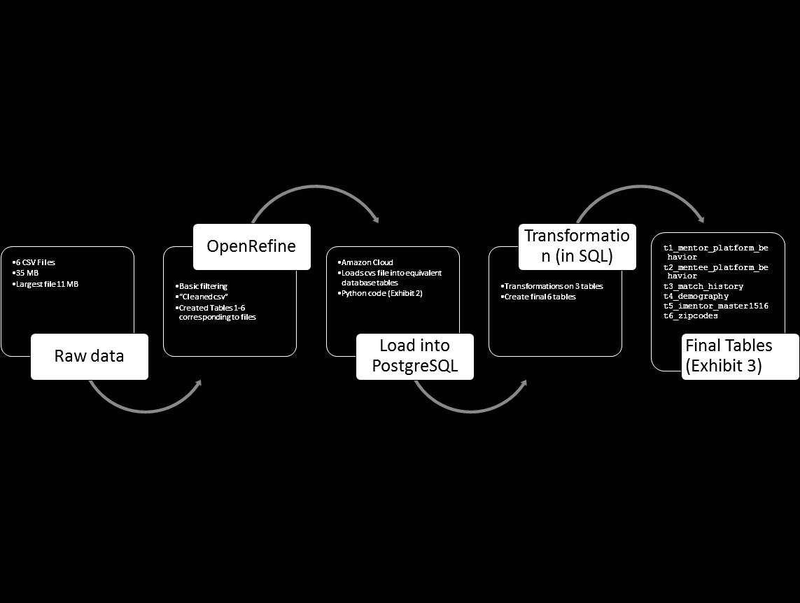
Extract - Load -Transform

Slide 11
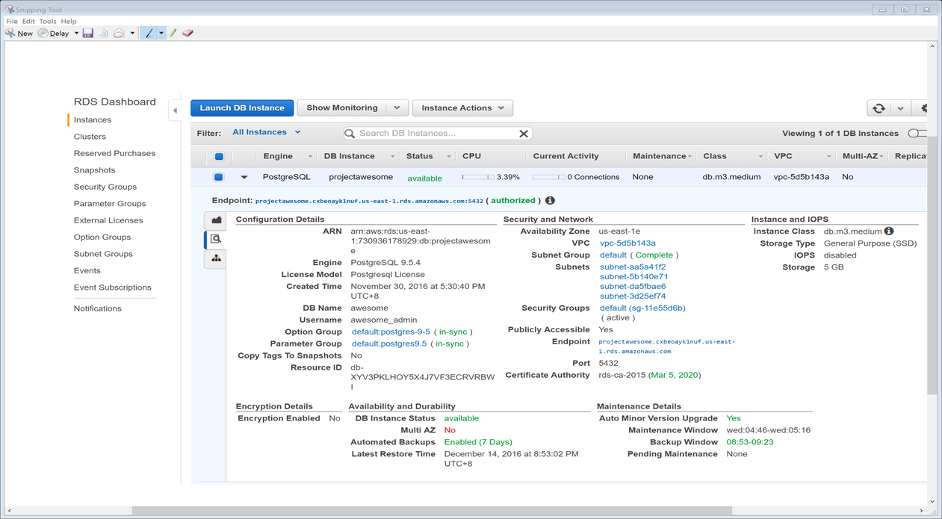
Our Database on Amazon

Slide 12
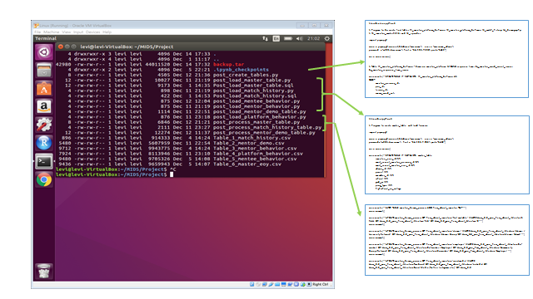
Data Processing App (10 sub-programs)

Slide 13
Schema (Final Tables)

Slide 14
3. Mentor demographic data
Predictive Analysis

Slide 15
Key Findings
Formal closure and dropout mentors group size significantly differ by program type
Demographic attributes are not sufficient alone to accurately predict probability of whether a mentor will drop out

Slide 16
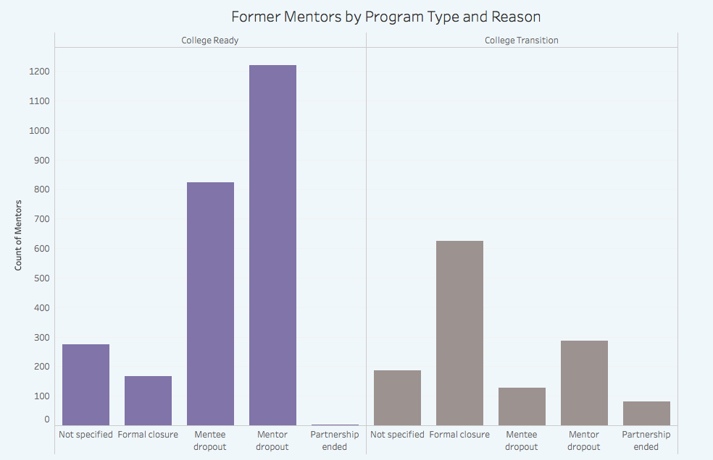
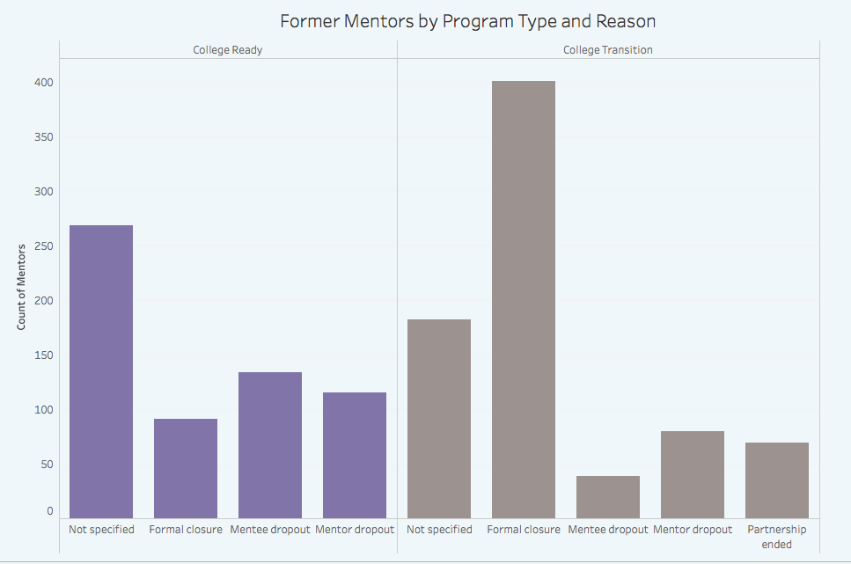
Program Types
Figure 1 - entire match history
4-yr program | mentor dropout > formal closure
3- yr program | mentor dropout < formal closure
Figure 2 - 2012 match start year
4-yr program | mentor dropout > formal closure
3- yr program | mentor dropout < formal closure
Observation: There are more mentor dropouts than formal closure for 4-yr program and the opposite case for 3-yr program. However in case of 4-yr program, such difference narrows for 2012 match start year cohort which covers a period of at least 4 years to 2016 data collection year.

Slide 17

Question:
Can mentors demographics attributes be indicators of mentor dropouts?
Method:
Predictive analysis by training mentors demographic attributes in a classification model

Slide 18
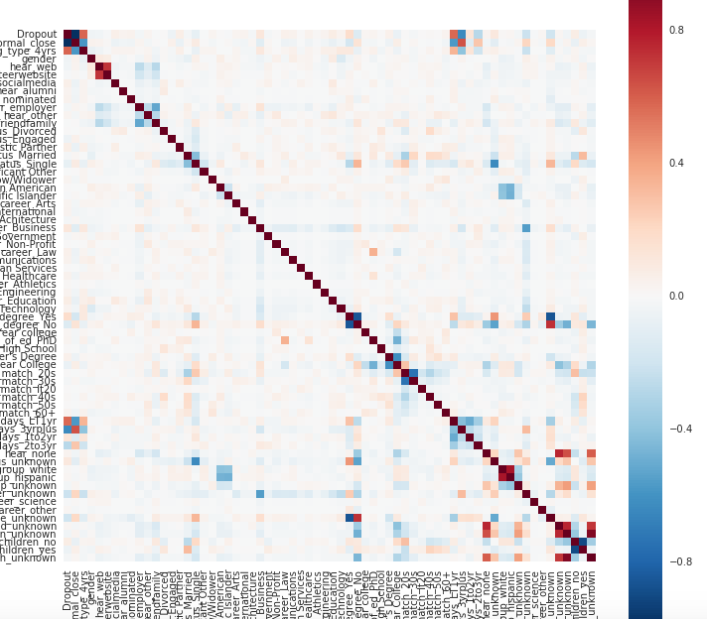
Mentors Demographic Attributes
Figure A. Dropout and Demographic features correlation matrix
List of attributes in the predictive analysis of dropouts:
Age at match
Gender
Marital status
Racial group
Career
Level of education
Parent college degree
Have children
How heard about iMentor
Note: some variables which contain overlapping characteristics (e.g. occupation vs. career) have been removed.
Figure A shows that not a lot of demographic attributes of mentors have a strong relationship with mentors dropouts

Slide 19
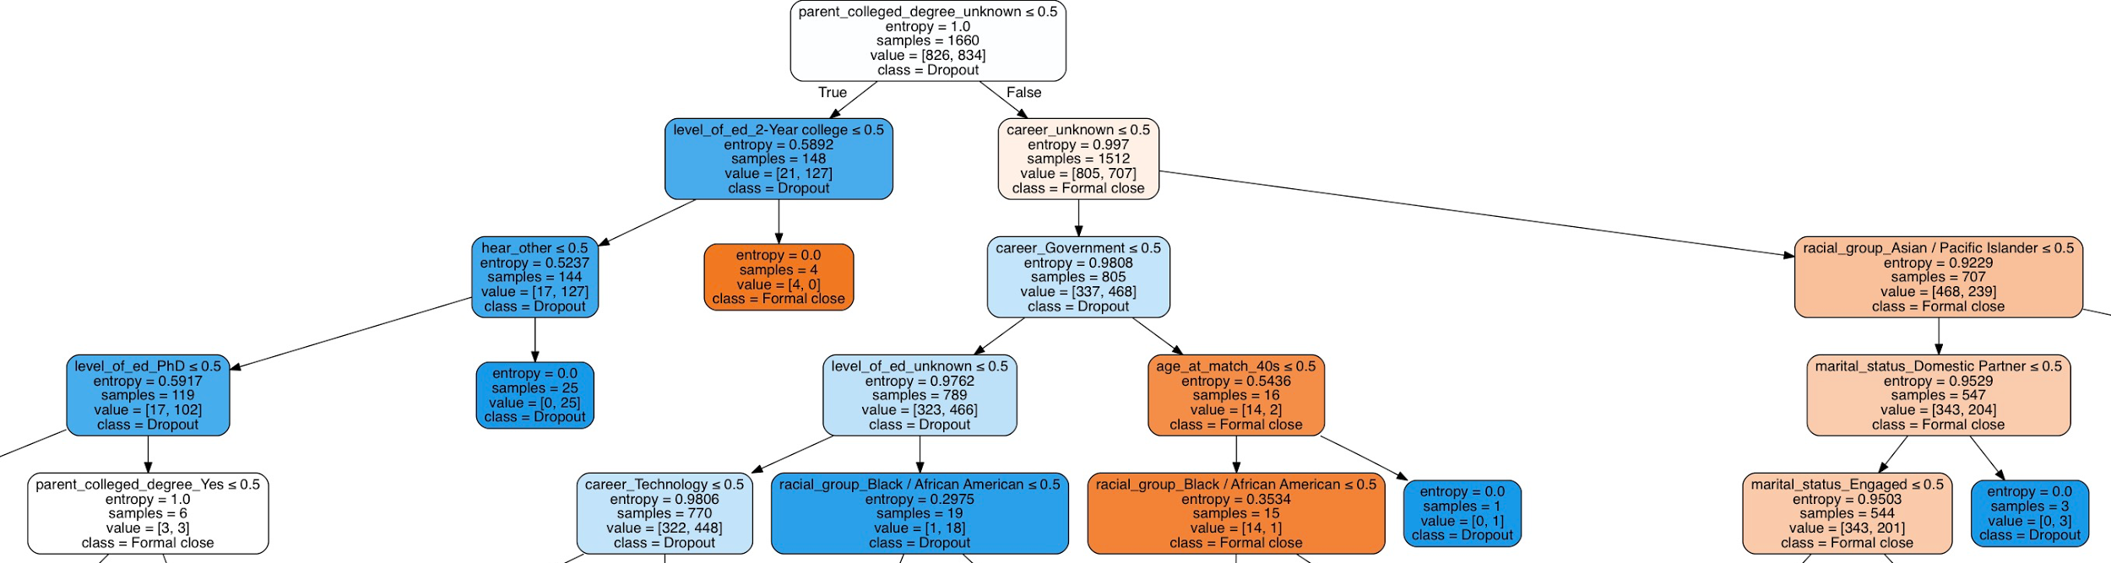

Predictive Analysis - Model
Algorithms used:
Unsupervised learning (PCA and clustering): not intuitive and lower accuracy
Decision Tree: easier to understand and better accuracy
Note: some bootstrapping techniques were used to balance out the number of dropouts and formal closure in the dataset
Figure 3 Extract of Decision Tree
Notes:
Unsupervised learning (PCA and clustering): reduce dimension and classify based on the clusters.
Top 10: means if binary variable = 1 then less likely to dropout

Slide 20
Predictive analysis - Findings
Top 10 most important predictive indicators:
Career - not specified
Parent college degree - not specified
Heard iMentor from employer
Level of education - 2-yr college
Career in Government
Racial group - African American
Racial group - Asian
Career in Tech
Level of education - not specified
Age at match - 30’s
Model accuracy: 65%
The low accuracy possible explanation:
Demographic attributes of mentors alone can only partially explain mentors likelihood of dropping out. As next step, features other than demographics will need to be explored and added to the current model
Small number of formal closure (i.e. the opposite label of mentor dropout) in the dataset in the 4 yr-program can weaken the predictive power of the model
Notes:
Unsupervised learning (PCA and clustering): reduce dimension and classify based on the clusters

Slide 21
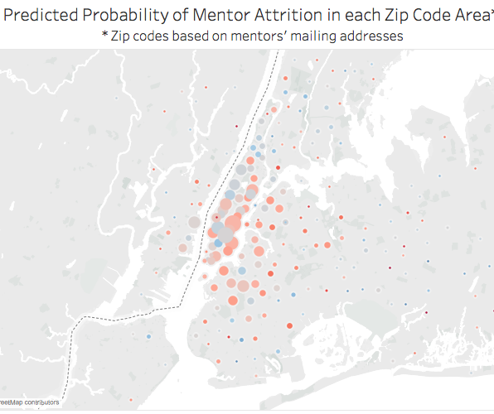
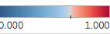
Predictive analysis - Possible Uses
Predict dropout probability of current mentors and detect potential group likely to dropout
Can be visualized on a map by school - see Figure B - Tableau demo (note mentors mailing zip code was used since school zip codes were not available)
Better understand factors related to mentors dropout to help better mentor recruitment
The prediction of mentors dropouts can also help for mentors population projection and resource planning
Figure B Map of mentors likelihood to drop out

Slide 22
4. Message traffic data
Time Series Analysis

Slide 23
Key Findings
No readily apparent behaviors distinguishing dropout mentors from other groups
Patterns suggesting decreasing mentor engagement over time

Slide 24

Message Traffic Data Description
Identifier for what week / lesson sequence each message was for
Time stamp for login and send
Message length
Mentor, mentee, and pair identifiers
School year 2015-2016
Dataset for mentee and mentor messages, both with about 90,000 observations

Slide 25
Mentor Groups
Methodology
Mentor dropout
Formal closures (program completion)
Mentee dropout
Open matches
Compare metrics across groups
Standardize measures calculating z score for each observation relative to mean and standard deviation for that particular mentor
Group by message sequence to observe trends leading up to match closure or end of observations

Slide 26
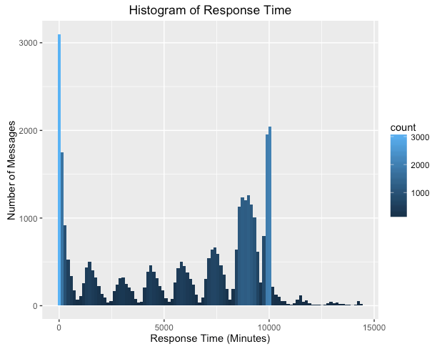
Response Time
Large number of mentors who respond quickly each week
Large spike as mentors rush to respond at the end of each week
Hoped to see more last minute responses for dropout mentors, but the distribution looked similar for all mentor groups

Slide 27
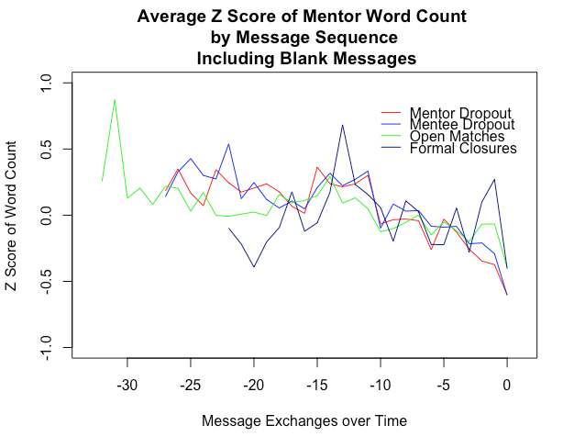
Word Count
Mentors write on average about two and a half times as many words as mentees, with mean message length for mentors of 191 words and 74 words for mentees.
Word count trends downward as mentors spend a longer time in the program

Slide 28
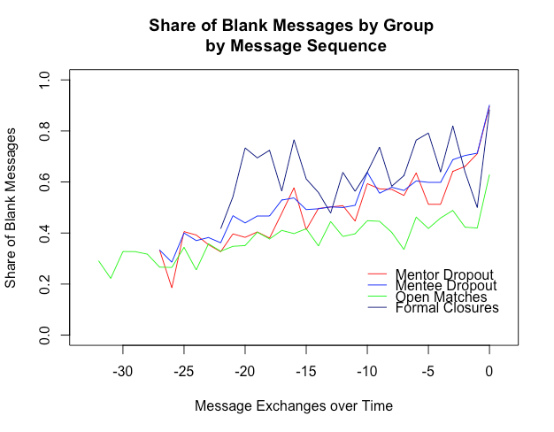
Blank Messages
Very distinct increase in blank messages over time for all groups
At least 40% of messages were blank for all groups
Strangely, formal closures had highest prevalence of blank messages, difference was statistically significant at the p < .001 level using pairwise t-test with Bonferroni correction

Slide 29
Conclusion
No strong indicators found to differentiate dropouts from formal closure:
Demographic attributes can partially train a prediction model but additional features should be added to complete the model
Message traffic analysis is based on one school year. Analysis over several years may reveal distinctions between dropouts and mentors who reach completion of the program

Slide 30
Proposed Next Steps
Data Architecture & Processing
Will need to work with raw files that are used to generate the master data file.
Need ability to “customize” tables for analysis -- data is currently heavily filtered manually
Message logs and content will increase rapidly over time. May need to investigate Hadoop for stability
Push demographics analysis back to cloud, create/update mentor dropout table with Bayesian statistics

Slide 31
Proposed Next Steps
Demographics Analysis
Combine demographic attributes of mentors with features that reflect mentors behavior within program (e.g. message frequencies), mentors interaction and relationship with mentees (same interests, hobbies, family background, racial group, languages, etc.) and other features (proximity of work/home to school, etc.)

Slide 32
Proposed Next Steps
Messages & Logs
Analyze patterns in chat, could be some interaction with blank messages
If changes are made to the program, repeat analysis to see if they seem to improve mentor engagement
Find out whether mentors begin to feel some fatigue over time
How do we explain consistent mentor disengagement?

Slide 33




The Team
Nicholas Chen
Stephanie Fan
Hyera Moon
Leslie Teo
Time Series Analysis Lead
Message traffic analysis
Data Visualization Lead
Tableau expert
Predictive Analysis Lead
Mentor demographic data analysis
ETL Lead
Data architecture, storage and retrieval expert

